Slide 2
There are actually two sample rate converters. One is on the Dual DSP board and does conversion prior to post processing. The second is just before the LVDS links to the D-to-A converters. Both run at 96kHz (which is the system clock rate) regardless of sampling frequency of the incoming stream.
The SRCs on the DSP board are in the circuit between the DSPs, so in general terms DSP A decodes the stream, PCM goes through the SRCs and DSP B performs the post processing. I’m told there are also some software SRCs used and that the main SRC takes place before the LVDS links to the DACs. We keep the SRCs on the digital side of the pcb layout. I was unable to open the hyperlink or get onto the mds site to check, but it’s possible that you’re looking at a photo of a different version of the DAE than we use. Their standard version has the DACs and volume controls included on the DSP board. We get a version without these and do D-to-A, volume and output buffers on our board.

Slide 3
complex programmable logic device (CPLD)

Slide 4
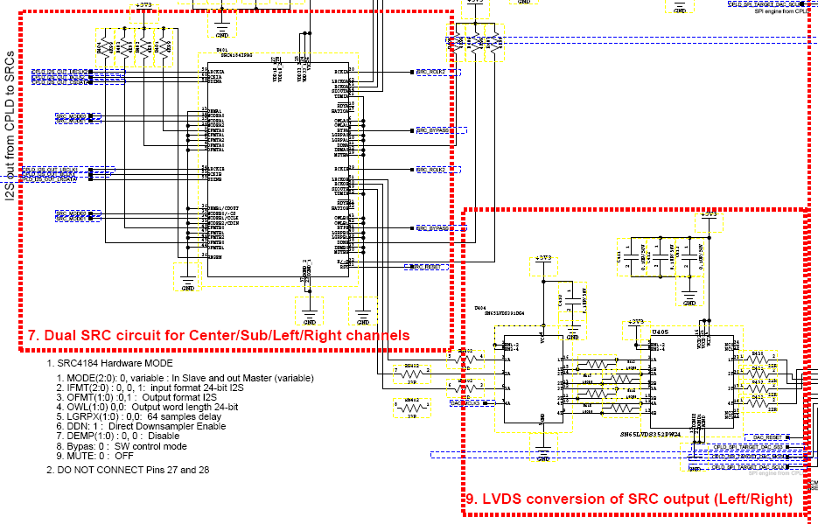

Slide 5
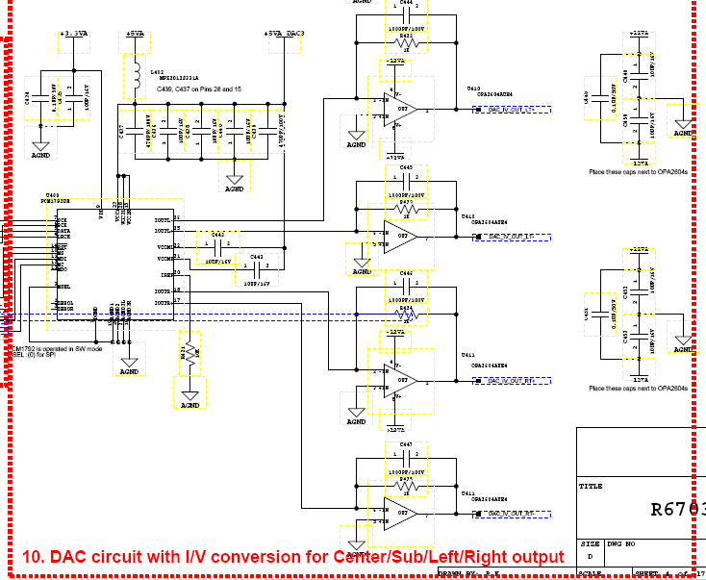

Slide 7
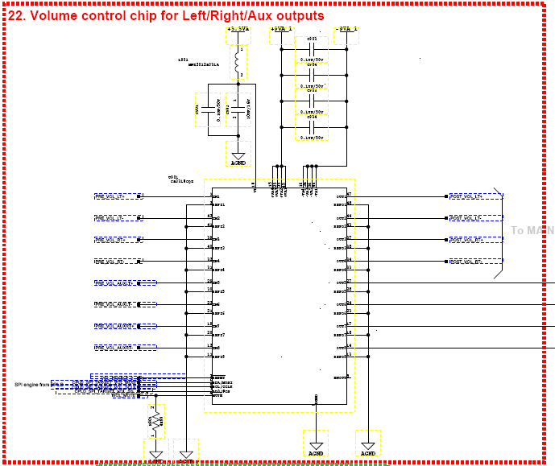

Slide 8
